Slide 1
Interactive Video Player
CS3249 Project
Group 3 – 1 Chua Chong Yun, He Haocong, Saluka Amarasinghe

Slide 2
System Objectives
Objective:
Create a simple tool to allow users to interact with what they are watching.
Eliminate the one sided process of watching movies or TV shows.
Target Users:
Individuals who watch movies or TV shows on their computer.

Slide 3
The System
Major Features:
Open and play any video file
Identify key parts of the video and make it user clickable
Provide relevant information about the selected feature from the video
Type of System:
Stand-alone application with a database of information for multiple movies/TV shows.

Slide 4
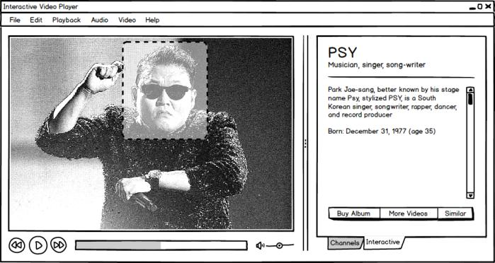
Initial GUI Design

Slide 5
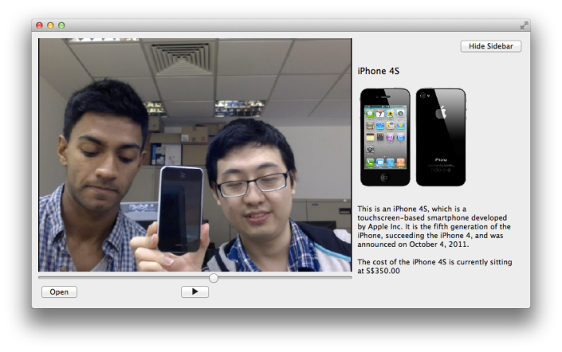
Final GUI Design

Slide 6
GUI Design Principles
Uses Qt 5.0 multimedia classes
Simple, clean and minimalistic
Video playing is the focus
Interactivity is a feature
Meta content is readily accessible and readable
No need for extra playback buttons

Slide 7
System Architecture
IVP
Main Window
Selectable Overlay
Interactive Sidebar
Video Player
XML Content
Meta Info Manager

Slide 8
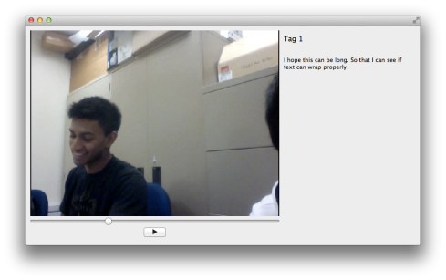
System Architecture
Main Window (QMainWindow)
Interactive Sidebar
(QScrollArea)
Video (QMediaPlayer drawn on QGraphicsView)
XML content
(QtXml)
Selectable Overlay
(QWidget)

Slide 9
System Architecture
The main window consists of the overlay, video player and sidebar.
The overlay and video player are stacked.
The sidebar is a fixed width QScrollArea. (300px wide)
Main Window
Video Player
Sidebar
Overlay

Slide 10
System Architecture
The overlay is where the clickable regions are created. It is stacked on top of the video player layer and spans the width/height of the video.
When a selectable region on the overlay is clicked a signal is sent to show the sidebar.
When a non-selectable region on the overlay is clicked the sidebar is hidden.
The sidebar shows all XML content

Slide 11
Difficulties & Issues
Having an overlay window on top of the video player for hover event detection (fixed by using QGraphicsView instead of QVideoWidget).
Having a sidebar that shows and hides while maintaining video aspect ratio
Parsing XML content for the sidebar
Progress bar for tracking time of video
Size of the open movie file gets reset immediately

Slide 12
Demo!

Slide 13
Future Changes & Conclusion
Requires a large database of pre-determined information for interactivity (no image recognition)
Moving images requires a moving selectable area.
Possibly implement face detection for the moving selectable area.
Image recognition will make our system more automated.

